Slide 1
Phase Ambiguities in Eta Photoproduction
A. Švarc
Rudjer Bošković Institute, Zagreb, Croatia

Slide 2

Wake up !
It might be interesting for you
after all

Slide 3
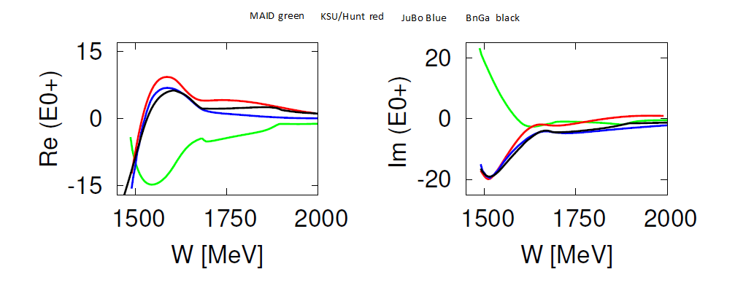
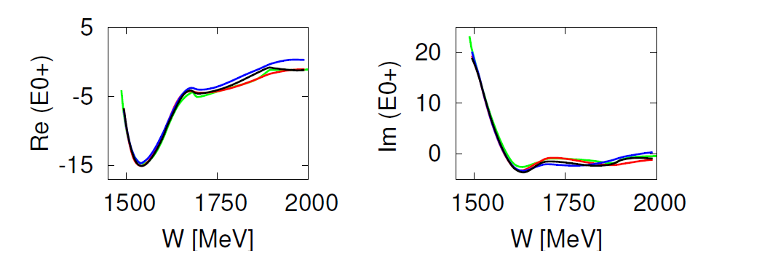

Slide 4
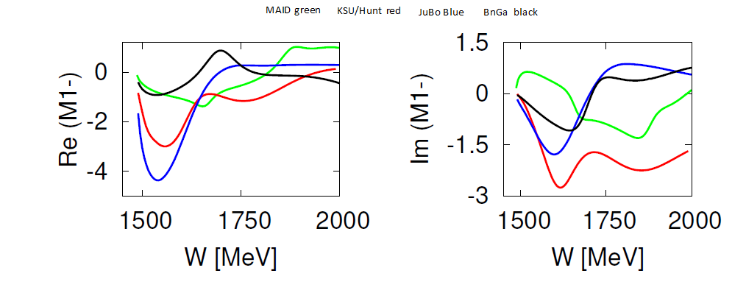
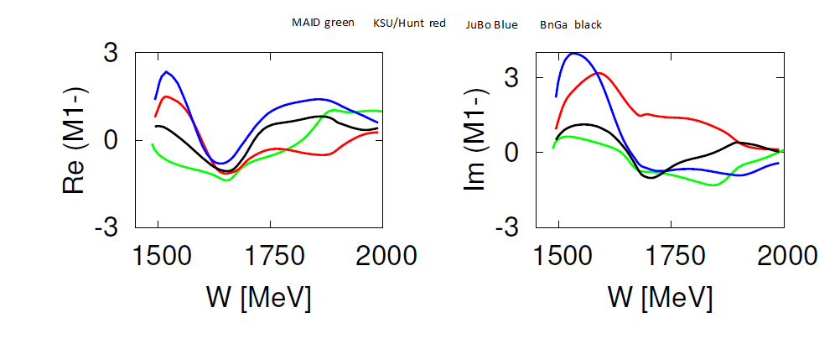

Slide 5
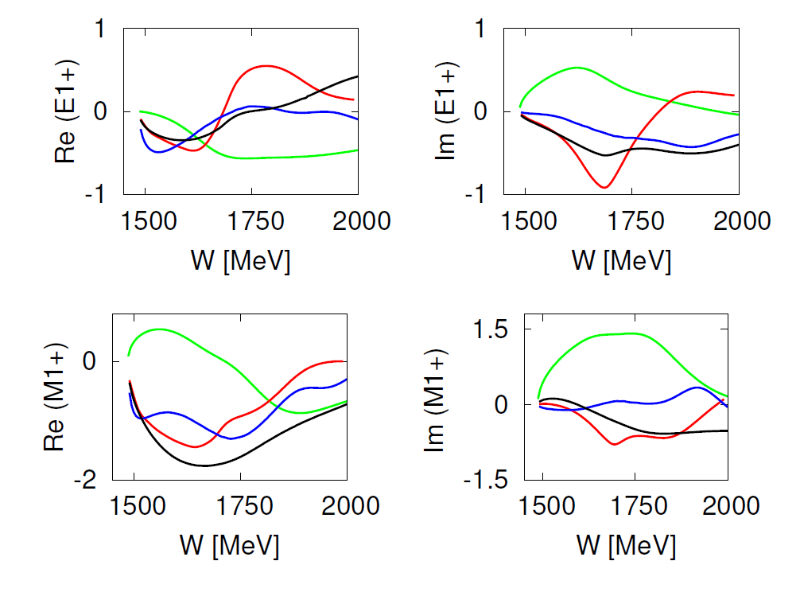
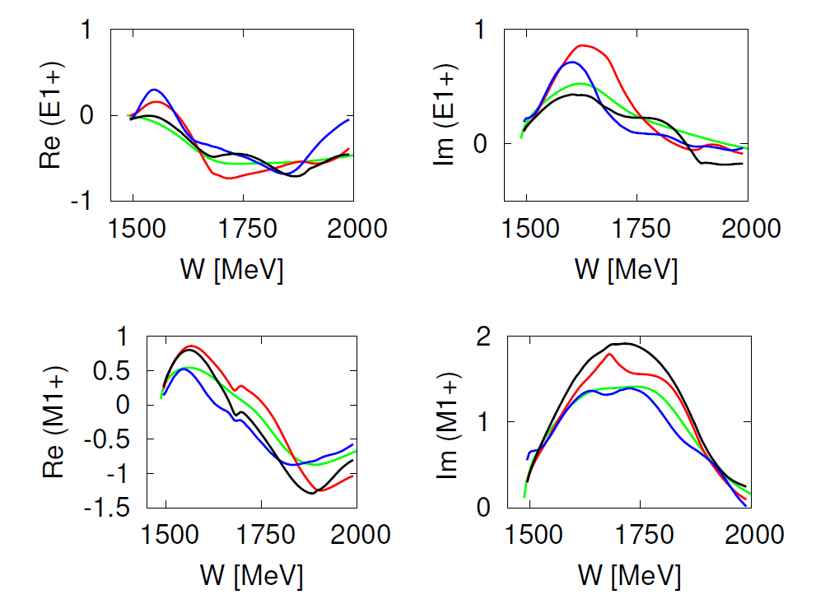

Slide 6
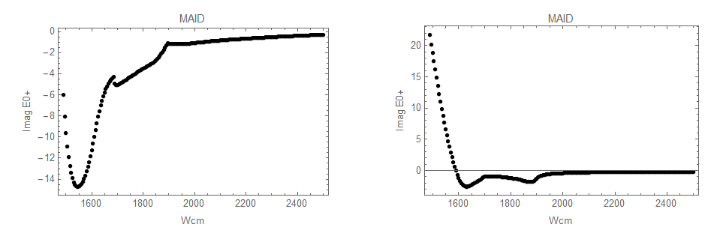
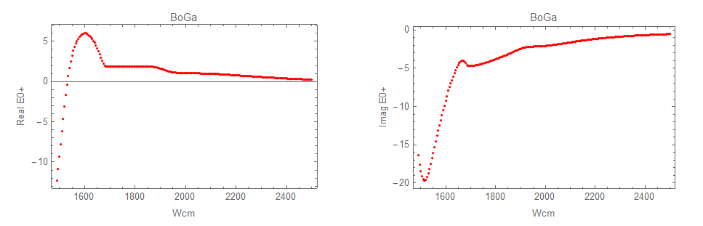
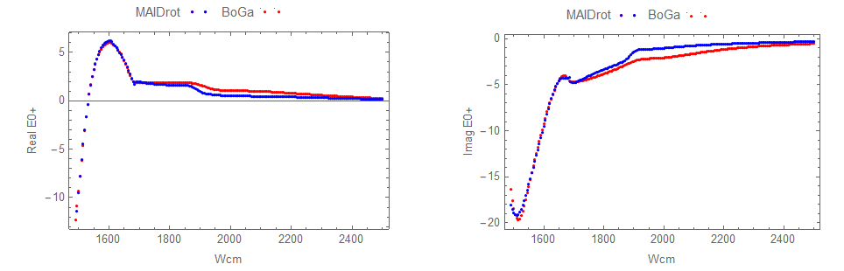

Standard way:
$$e^{i Φ(W)}= e^{i (− Φ_{MAID} + Φ_{BG})}$$
For all partial waves

Slide 7
Then:
  All poles in all partial waves remain unchanged
  Absolute values of all residues remain unchanged
  Only the residue angle is rotated
?
Is energy rotation all there is?

Slide 8
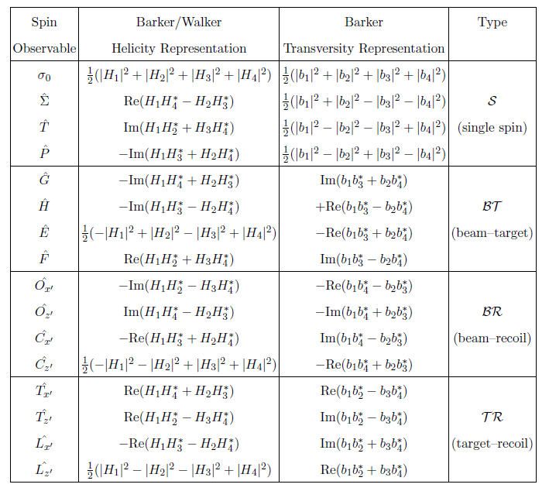
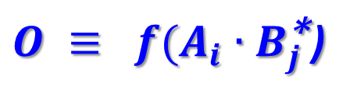
$O ≡ f(A_{i}{∙B}_{j}^{\text{∗}}$)

Slide 9
9
The simultaneous transformation of all reaction amplitudes
1-fold rotation does not change anything!
A consequence:
ALL SC OBSERVABLES ARE INVARIANT WITH RESPECT TO
ENERGY AND ANGLE DEPENDENT PHASE ROTATION
where Φ(W,Θ) is an arbitrary energy and ANGLE dependent real function!
This is called CONTINUUM AMBIGUITY!

Slide 10
Illustration on realistic example: MAID 2018 vs BoGa (web)
I will show helicity amplitudes at Wcm = 1769 MeV for three cases:
  MAID 2018 …………………………………………………. (red)
  BoGa ……………………………………………………….. (black)
  MAID 2018 rotated to BoGa E0+ phase ………. (blue)

Slide 11
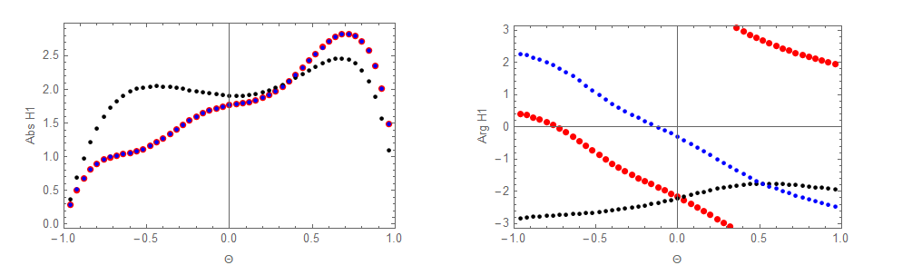
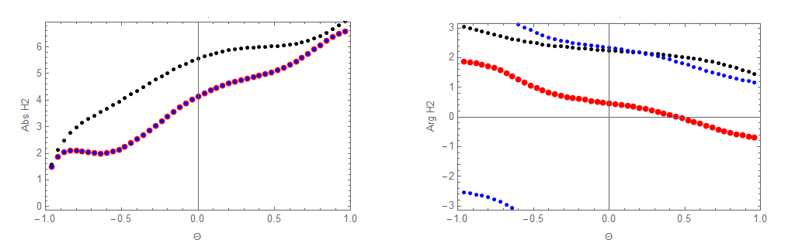
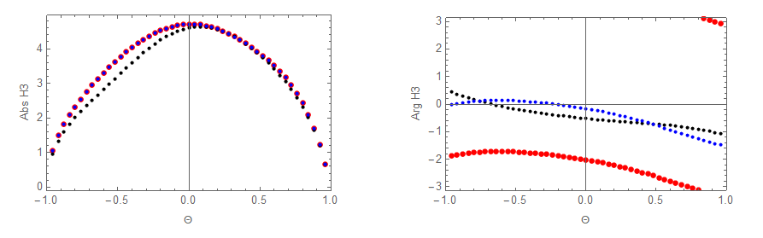
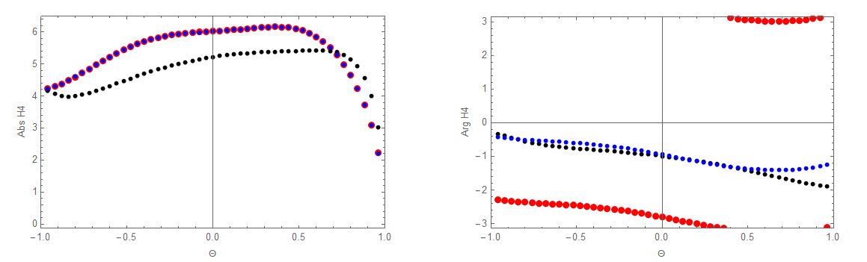
H1
H2
H3
H4

Slide 12
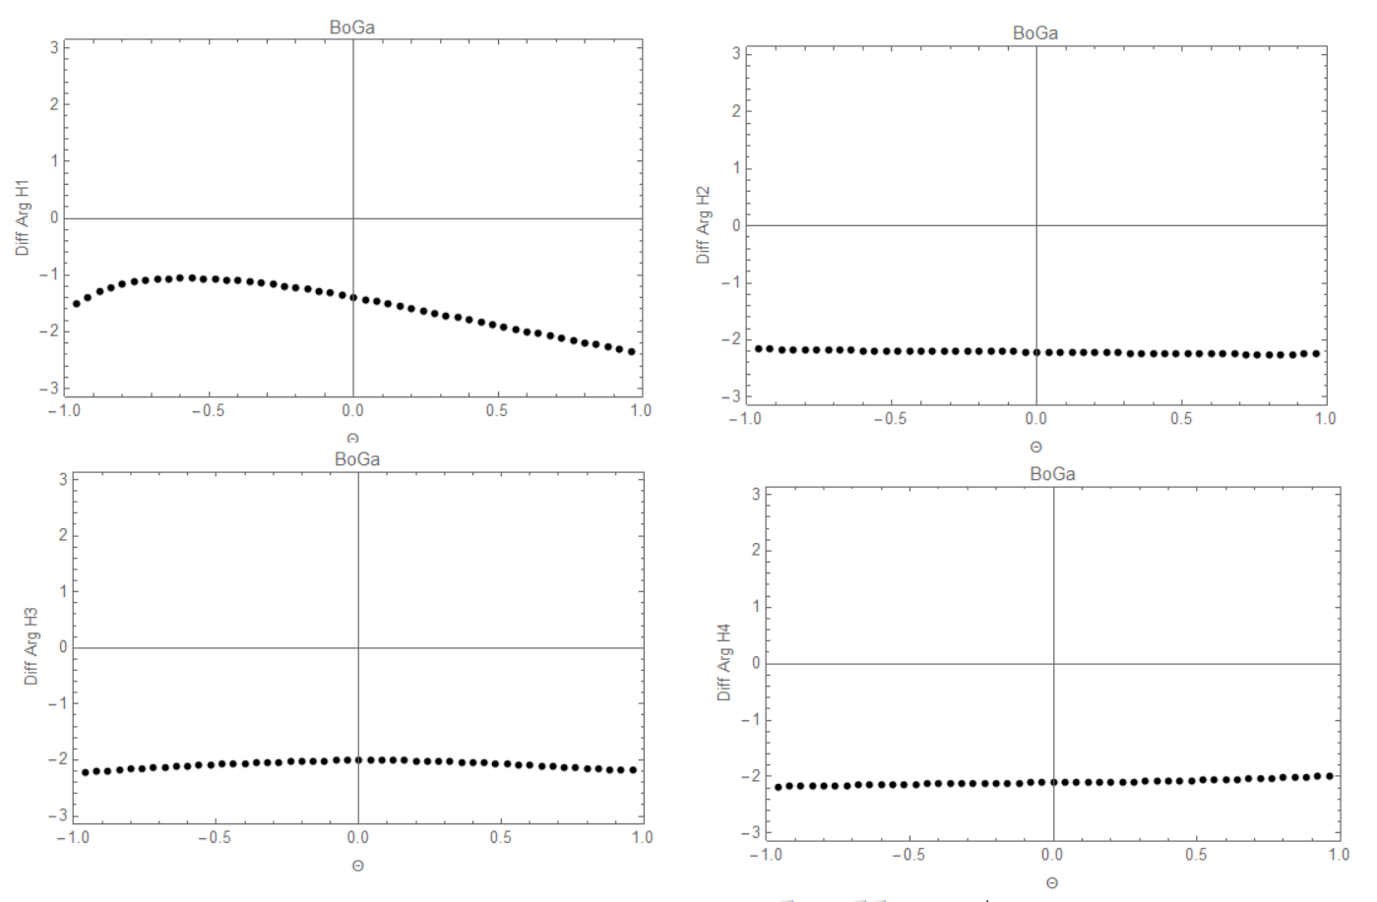
Difference of phases MAID - BoGa
H2
H1
H4
H3
Adding 2 at all angles at this particular energy will give MUCH BETTER AGREEMENT than matching E0+ phase

Slide 13
Conclusion:
There are visible differences between BoGa and MAID helicity amplitudes rotated to BoGa E0+ phase on the level of partial waves in angular part for all four helicity amplitudes! Energy dependent rotation did not cover it all!
So, if we want to replace MAID phase with BoGa phase at the level of reaction amplitudes we have to introduce and include effects of angle dependent phase rotation too.
So, we have to know what is invariance with respect to angle dependent phase rotations doing to multipoles.

Slide 14
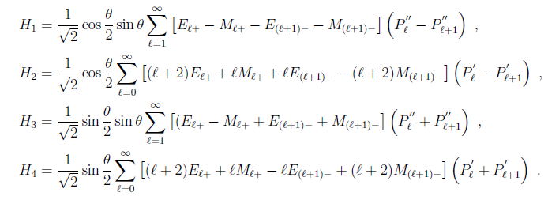
Let us see what is the influence of angle dependent continuum ambiguity upon a partial wave decomposition!
Example
For η photoproduction we use helicity amplitudes defined as

Slide 15
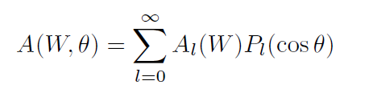
Let us simplify things somewhat and let us analyse scalar case!
In practice we deal with the general problem

Slide 16


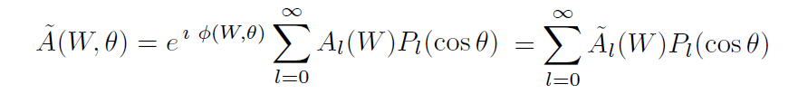

So, our problem is:

Slide 17
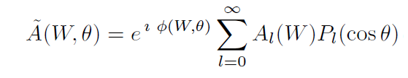
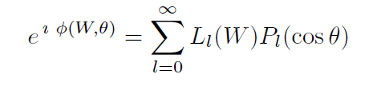
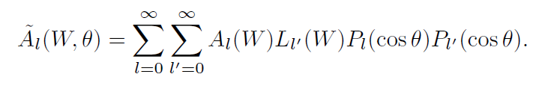
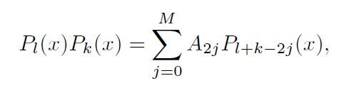
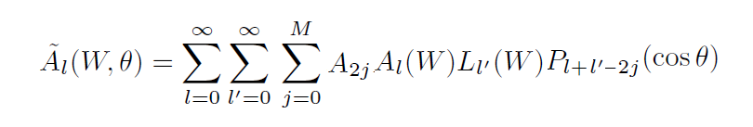

Change of summation index
k = l + l ’ – 2j

Slide 18

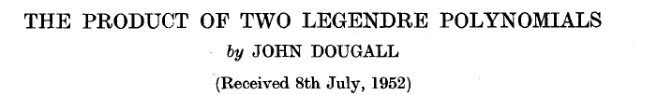

is a long time ago given in
However, Yannick Wunderlich has in his thesis
Derived a very nice closed formula:
Angle dependent phase rotations change residues and mix multipoles

Slide 19
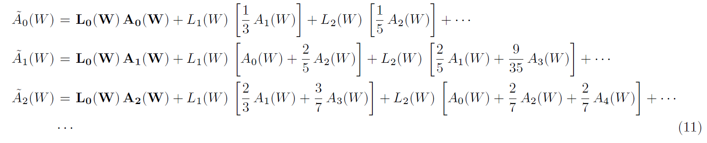
Explicitly:

Slide 20
Conclusions:
  In energy dependent phase rotations only residue angle is influenced
  In energy and angle dependent phase rotations absolute value of residue can be changed
  In principle, angle dependent phase rotation MIGHT mix resonances (move resonance from PW to PW)

Slide 21
Why is phase important at all ?
Reaction amplitude phase is IN PRINCIPLE, for the complete set of observables, measured in all channels with infinite precision, FULLY DETERMINED.
Ambiguities arise as the consequence of the loss of unitarity which is often caused with the incompleteness of experimental data set!
  Insufficient number of channels (single channel analysis, or too few channels)
  Incomplete set of observables
  Too high error bars

Slide 22
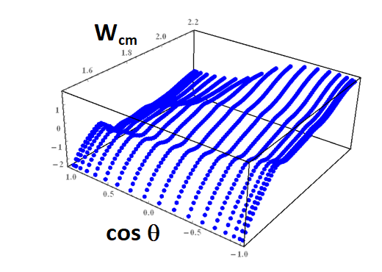
In ED calculations:
Phase is build into the model from the very start because of assumed analyticity!
When we have two models, we solve them, fit them to the same data base, and compare the resulting reaction amplitudes.
Phases might be different:
  Due to model differences
  Due to incompleteness of the data base
When we compare two models we have to match the phase ON THE LEVEL OF AMPLITUDES.

Slide 23
In SE calculations matching the phase is much more important.
We all know that unconstrained SE PWA is discontinuous.
No one explicitly discussed WHY !
Let me show you what is happening!
(phase is directly related to the continuity of SE solution)

Slide 24
We perform
SINGLE ENERGY
UNCONSTRAINED
L_{MAX} = 5
truncated PWA of η photoproduction
complete set of
pseudo-data

Slide 25
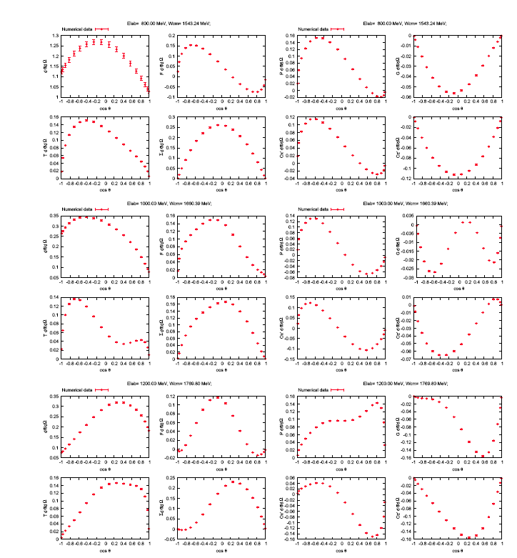
G
Data
dσ/dΩ
F
P
O_{z’}
T
Σ
C_{x’}

Slide 26
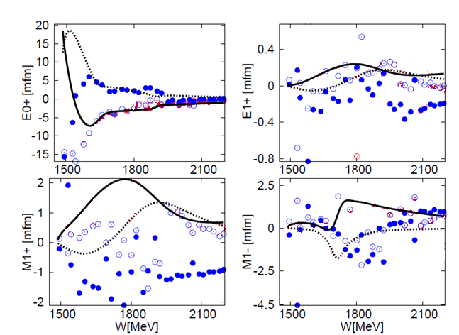


Slide 27
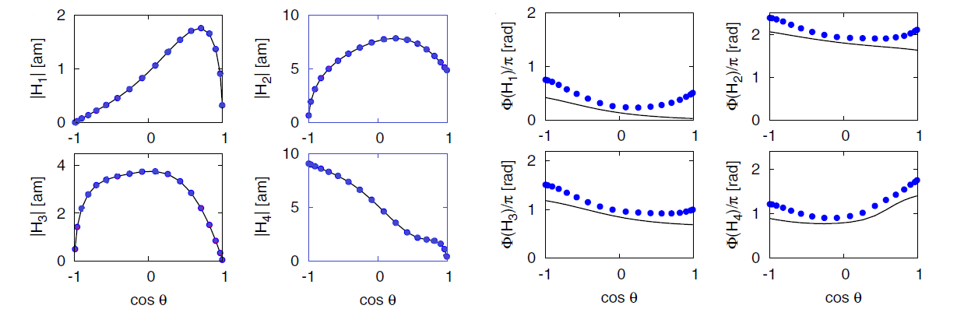
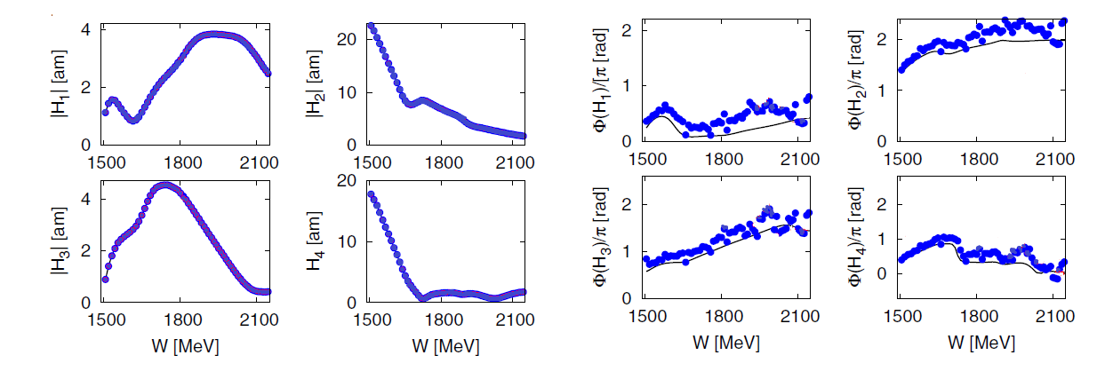

Slide 28
Let us plot THE PHASE of helicity amplitude H₂

Slide 29

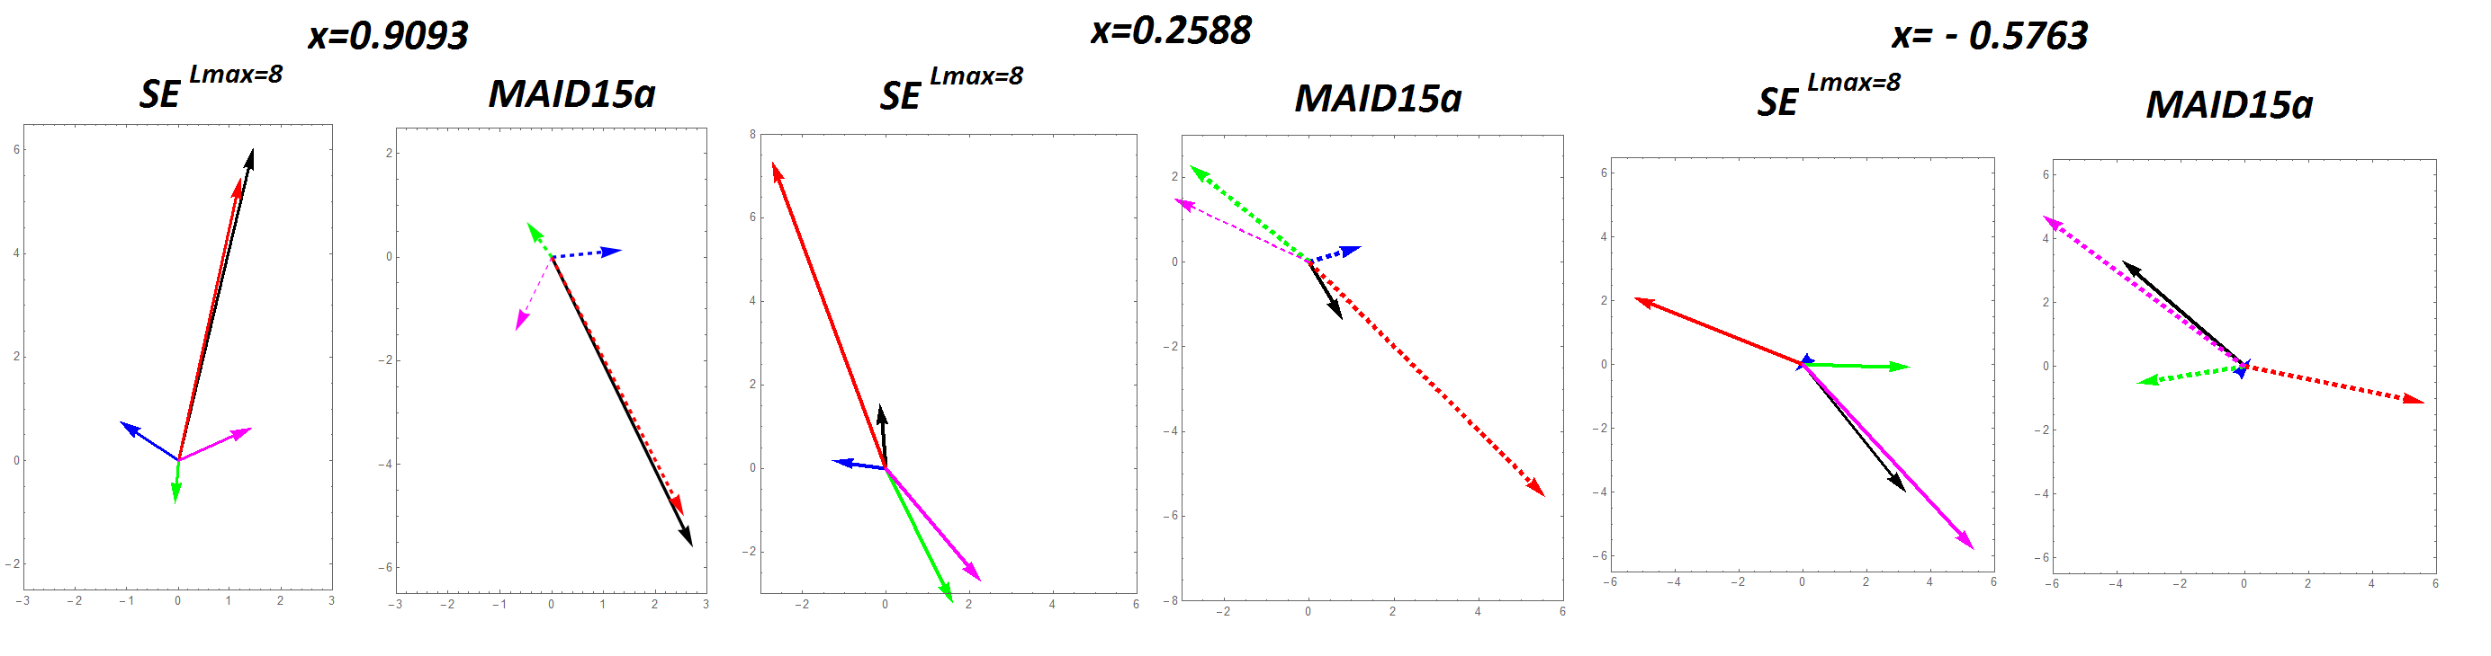

Let me solve the problem

Slide 30



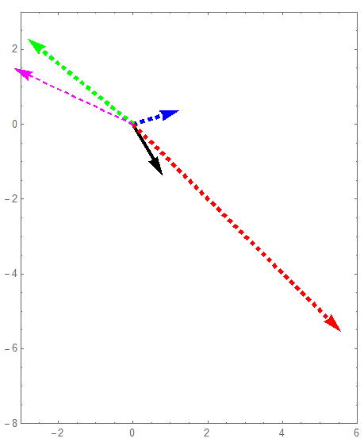

Slide 31
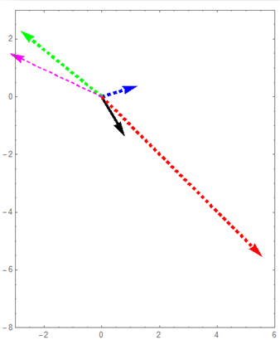

Slide 32
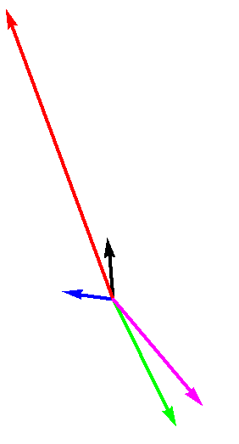
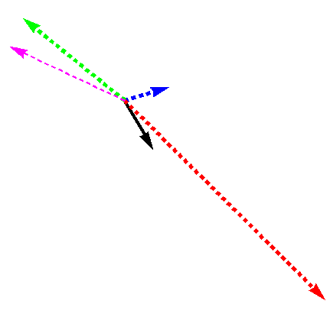
32

Slide 34
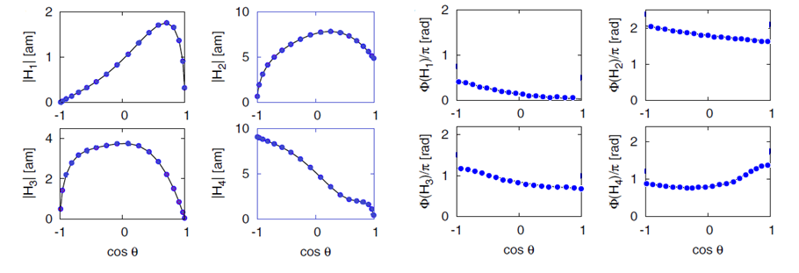
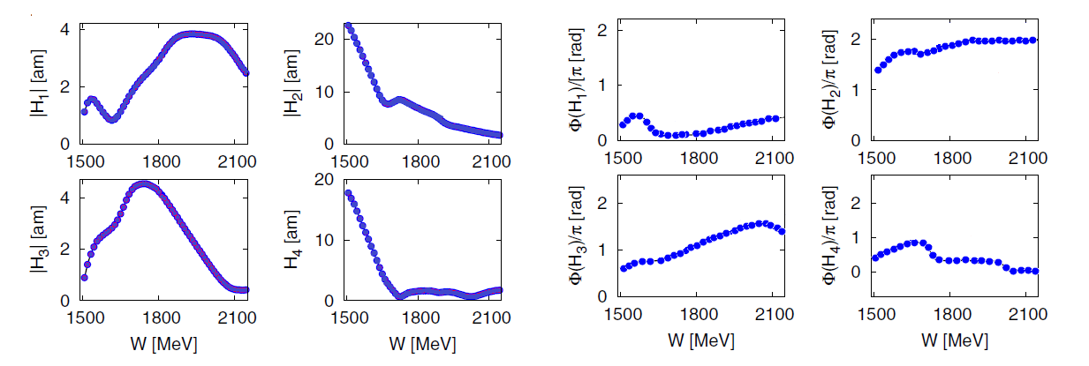

Slide 35

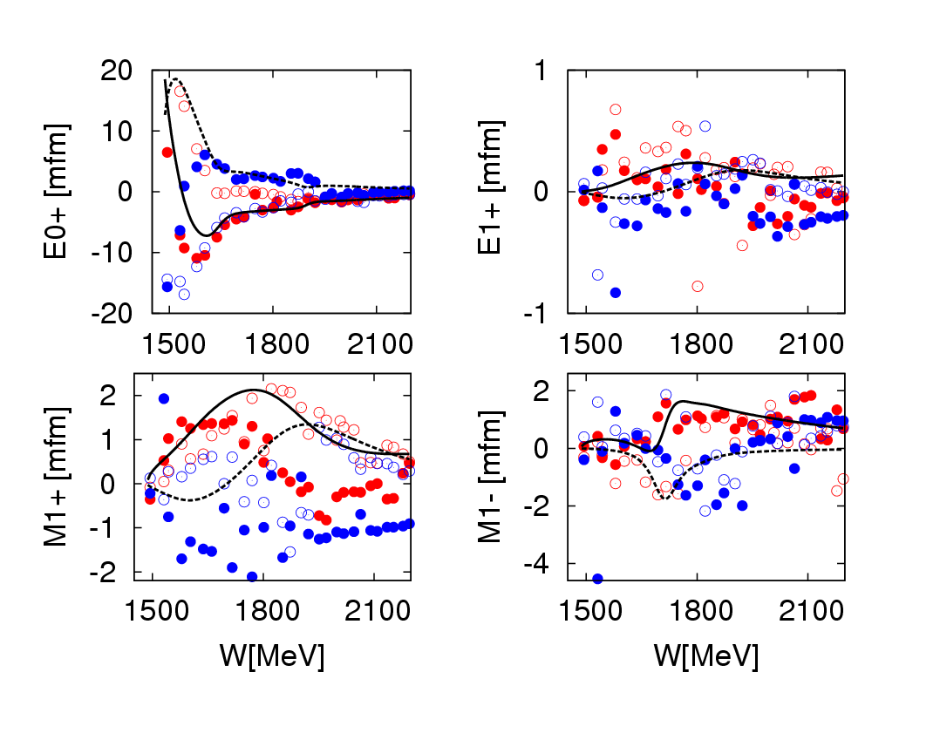
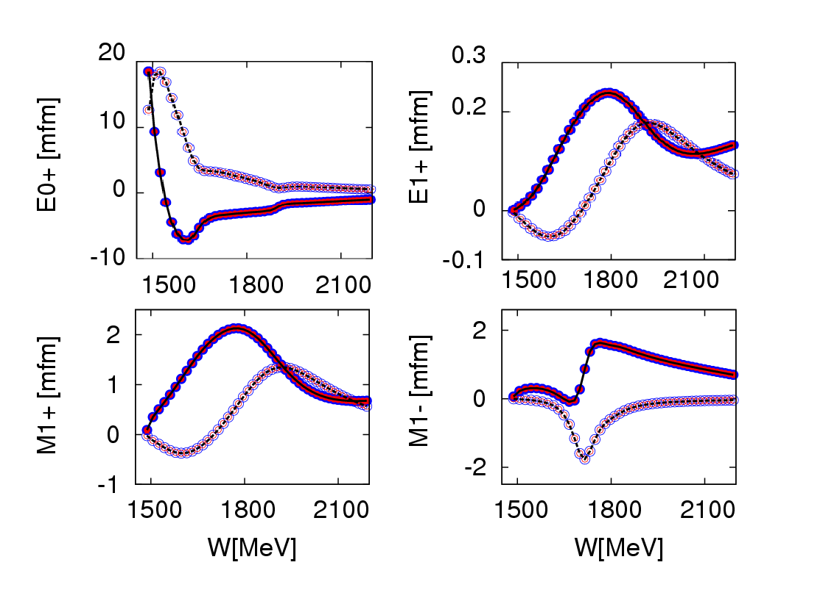

VERY IMPORTANT!
we obtain the „anchor” point

Slide 36
So, in SE PWA in order to get a continuous solution reaction amplitude phase has to be fixed!
It has been done in several ways:
  Truncation and constraining the phase of a specific (usually dominant) partial wave to the ED model values (MAID and SAID in pion photoproduction - late 2000s)
  Fixing higher partial waves to ED model values (Bonn-Gatchina in KL photoproduction – late 2010s)
  Iterative procedure SE – ED – SE – ED (Kent State in CC calculation - late 2010s)
  ***************************************************
  Imposing fixed-t analyticity ( Karlsruhe-Helsinki PWA in pN elastic - early 1980s)
THEORY DEPENDENT

Slide 37
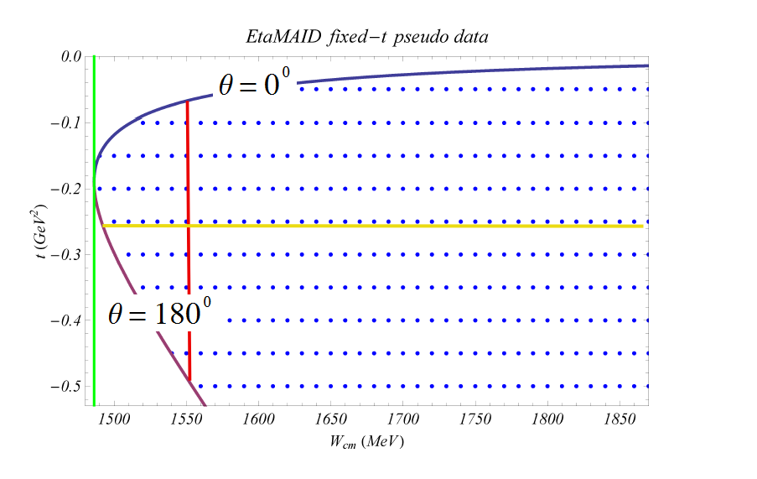


Slide 38
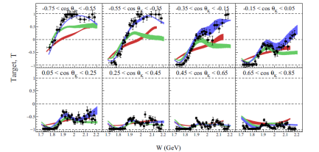
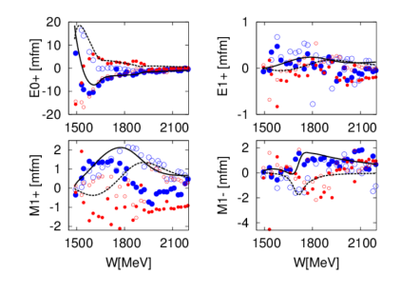
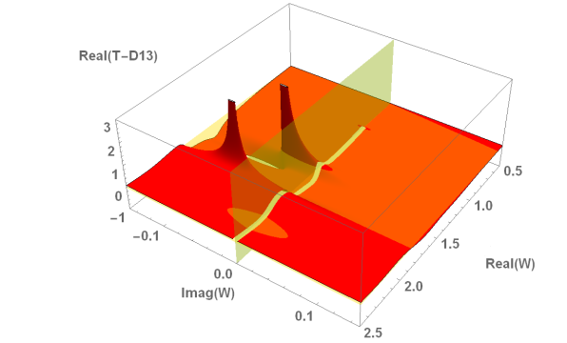
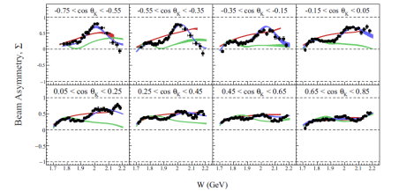

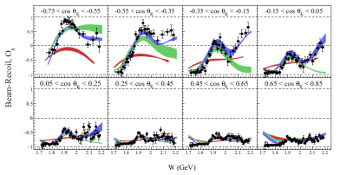
Main task
Poles as resonance signal
Experiment
PWA
MODEL
SE PWA
MODEL
Fixing phase via fixed – t analyticity
Laurent
+ Pietarinen
From Experimental Data to Pole Parameters in a Model Independent Way

Slide 39
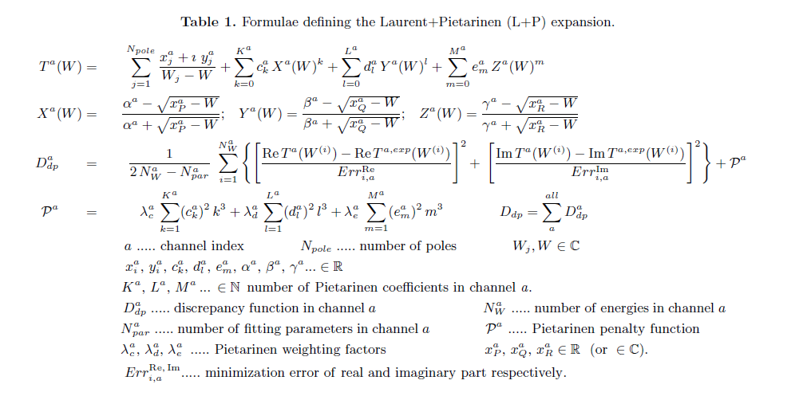
L+P method is tested and well documented
Conformal-mapping generated fast converging expansion of regular part of Laurent decomposition around physical branchpoints in the limited part of 2-nd Riemann sheet of complex energy plane near real axes

Slide 40
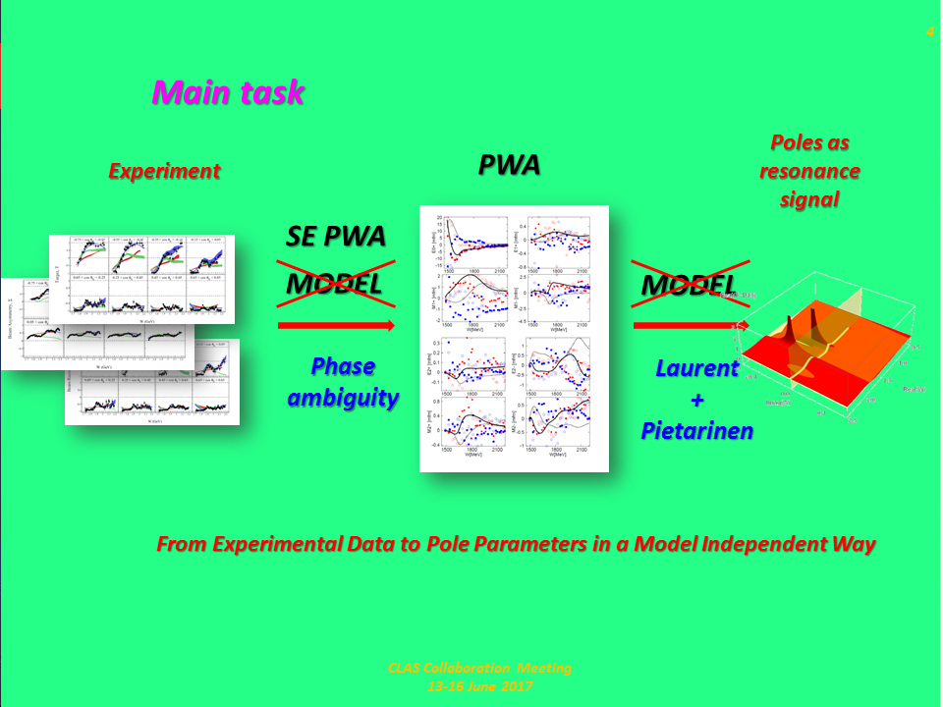
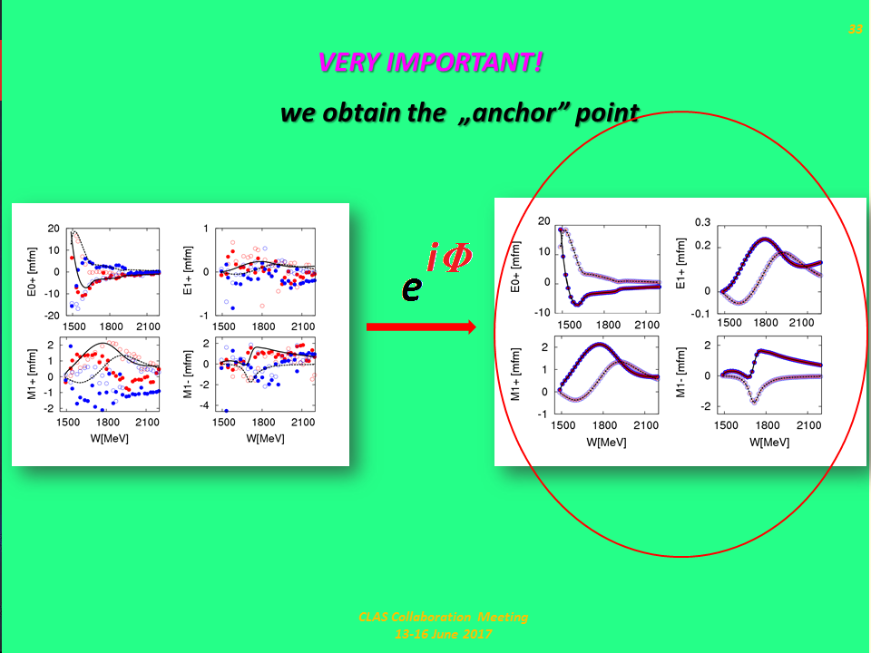
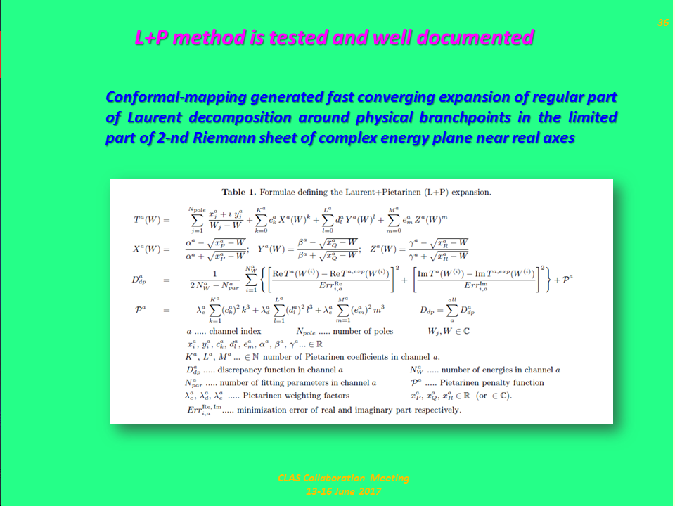
SUM
MARY

Slide 41


Future prospects
We need hard work…
We have the tool

